Slide 1
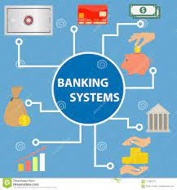
GROUP-2 BANKING SYSTEM

Slide 2
Presented by:-
Rachala Manisha(46281801)
Aishwarya Palled(46282510)
Swathi B.R. (46282511)
Shridevi Prabhu S(46282519)
Geethanjali
Goddumarri(46282520)
Mallela Reddy priya(46282530)

Slide 3
CONTENTS:
Introduction
Requirements
Problem Statements
Functional Specifications
Technical Specifications
Flow chart
ER Diagram
Modules
Features
Benefits
Conclusion

Slide 4

Introduction:
Banking System is a software for solving financial applications of a user in banking environment in order to nature the needs of an end banking admin by providing various ways to perform banking tasks.
The banking system is an application for maintaining to sore all data in sorted order of account number or customer number, to access to view all accounts , update details, deposit, withdraw the cash and also check balance.
Register as customer, where customer id should be auto generated in the system.

Slide 5

Requirements:
Problem Statement
Functional Specifications
Technical Specifications

Slide 6
Problem statement:
Banking System is a simple console application without graphics. It is similar to the one we use in real time by visiting banks where, any customer can make truncations and can owe multiple accounts with the same bank.

Slide 7
functional specifications:
All records are saved in a file.
Key features of the system are:
Login as admin: there exists only one admin for the system.
Register as new customer: Any new customer should be allowed to register for opening an account.
Login as customer: existing customer can login and perform transaction, update details for any of his/her multiple accounts.

Slide 8
Technical specifications:
Use data-structures for storing data before adding it to file (i.e. Linked list).
Data Validation should be implemented where length of the phone no. should be 10 , email id must contain @
If you store date then check if the date is valid or not before storing in the file.
Write optimized logic for searching as time complexity should not get increased while searching any information.
For this you can store all data in sorted order of account number or customer number.

Slide 9
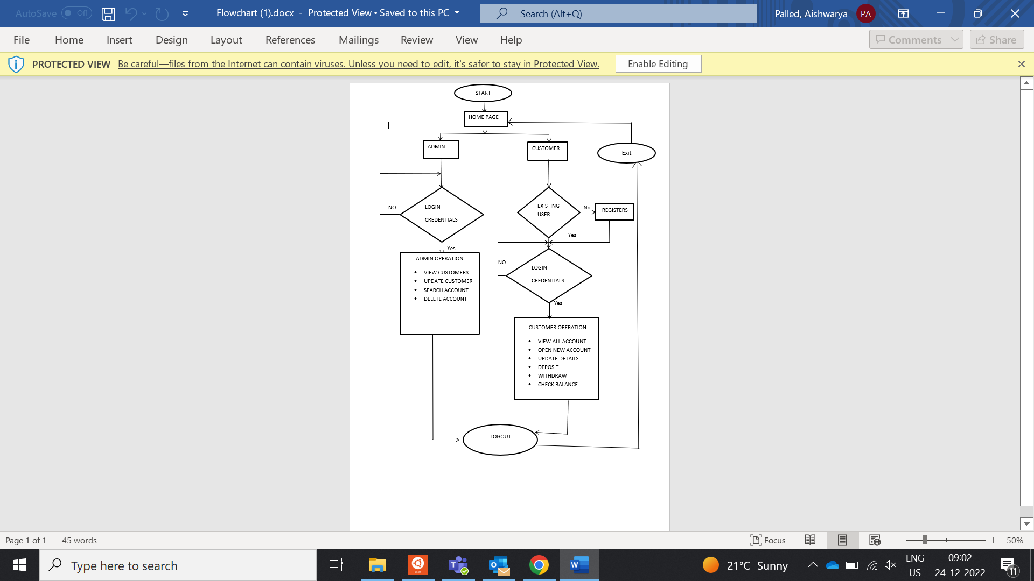
FLOW CHART:

Slide 10
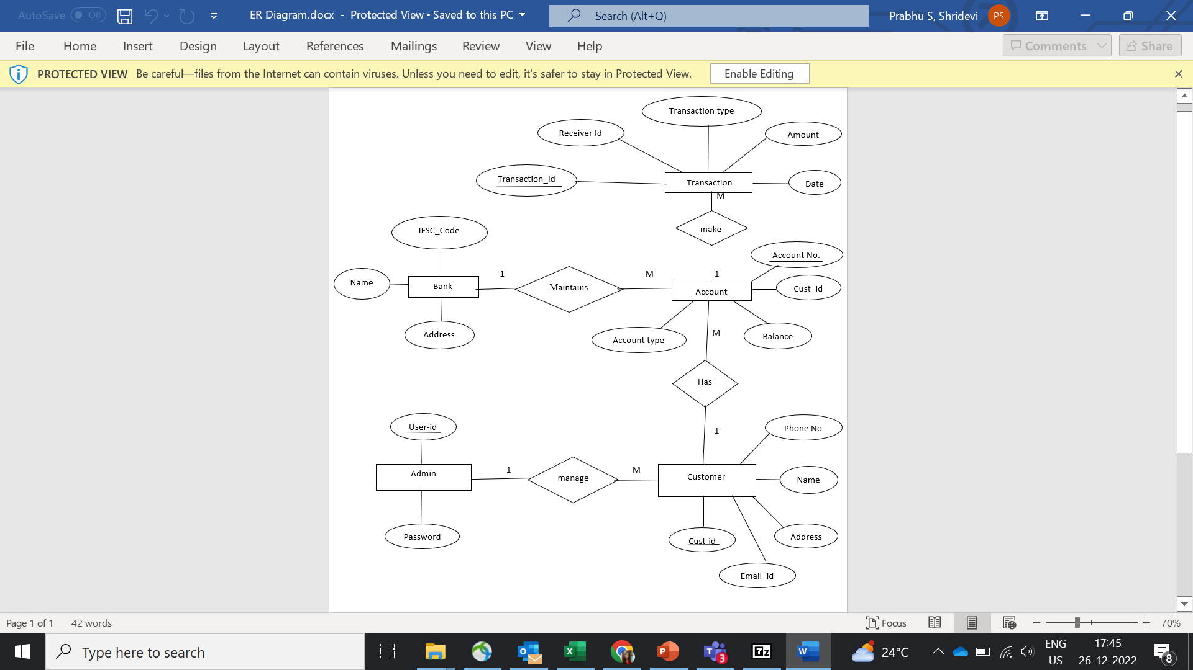
ER DIAGRAM:

Slide 11
MODULES:
Login Module
Admin Module
Customer Module
Customer Register Module
Validation Module

Slide 12
FeaTURES:
Excellent Security.
Withdrawal and Payment facilities.
Online and Mobile Banking.
Email and Text Alert.
Deal with Money.

Slide 13
BENEFITS:
Accessibility.
Safety.
Identity.
Liquidity- It provides high liquidity especially when a person needs a ready pool of money for emergency purpose.

Slide 14
Conclusion:
Banking holds a crucial role in our day-to-day life. Banking system is responsible for citizens.
As the banking sector is playing a vital segment of a modern economy.

Slide 15

THANK YOU

